Slide 2
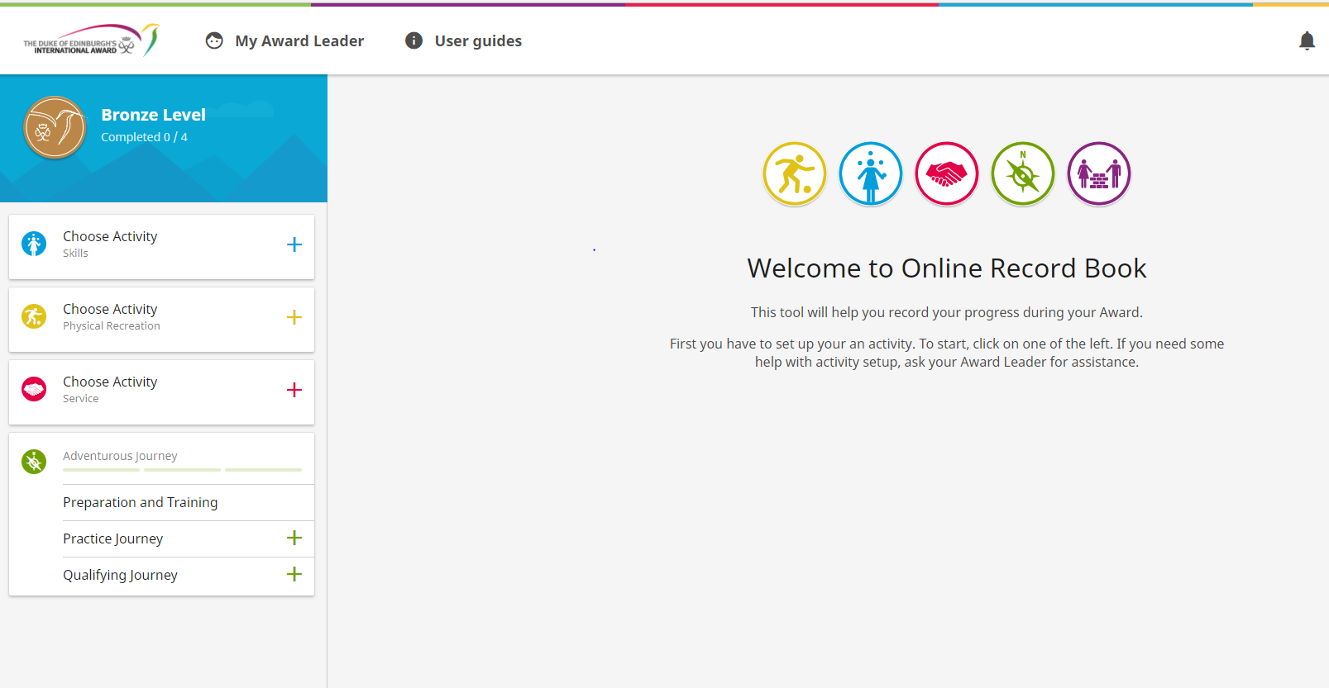
ONLINE RECORD BOOK (ORB)

Slide 3
SET UP YOUR ACTIVITIES

Slide 4
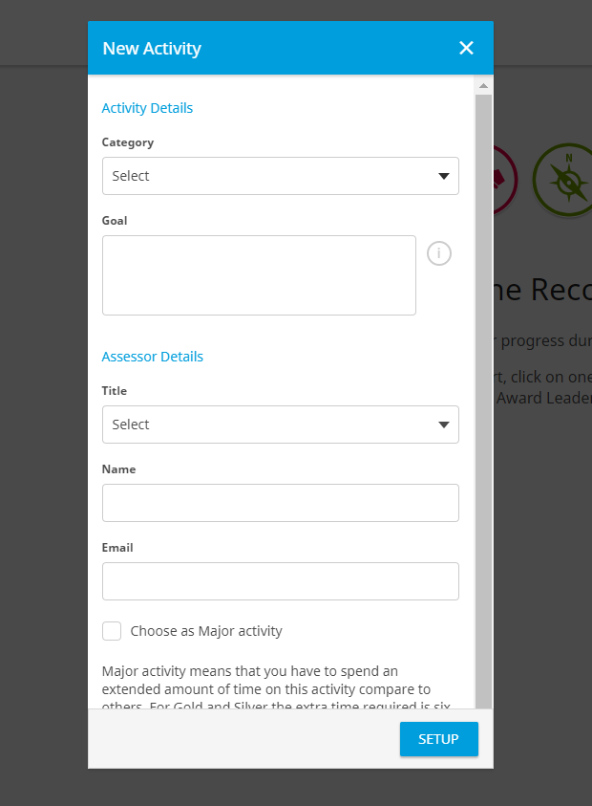
NEW ACTIVITY
Assessor (Subject Matter expert) – Signs off on completion of your activities. Please enter valid email address
MAJOR = 6 month activity. Choose either Skills, Voluntary Service, or Physical Recreation.

Slide 5
SET UP ACTIVITIES
Activity set up!
Just awaiting Award Leader approval

Slide 6
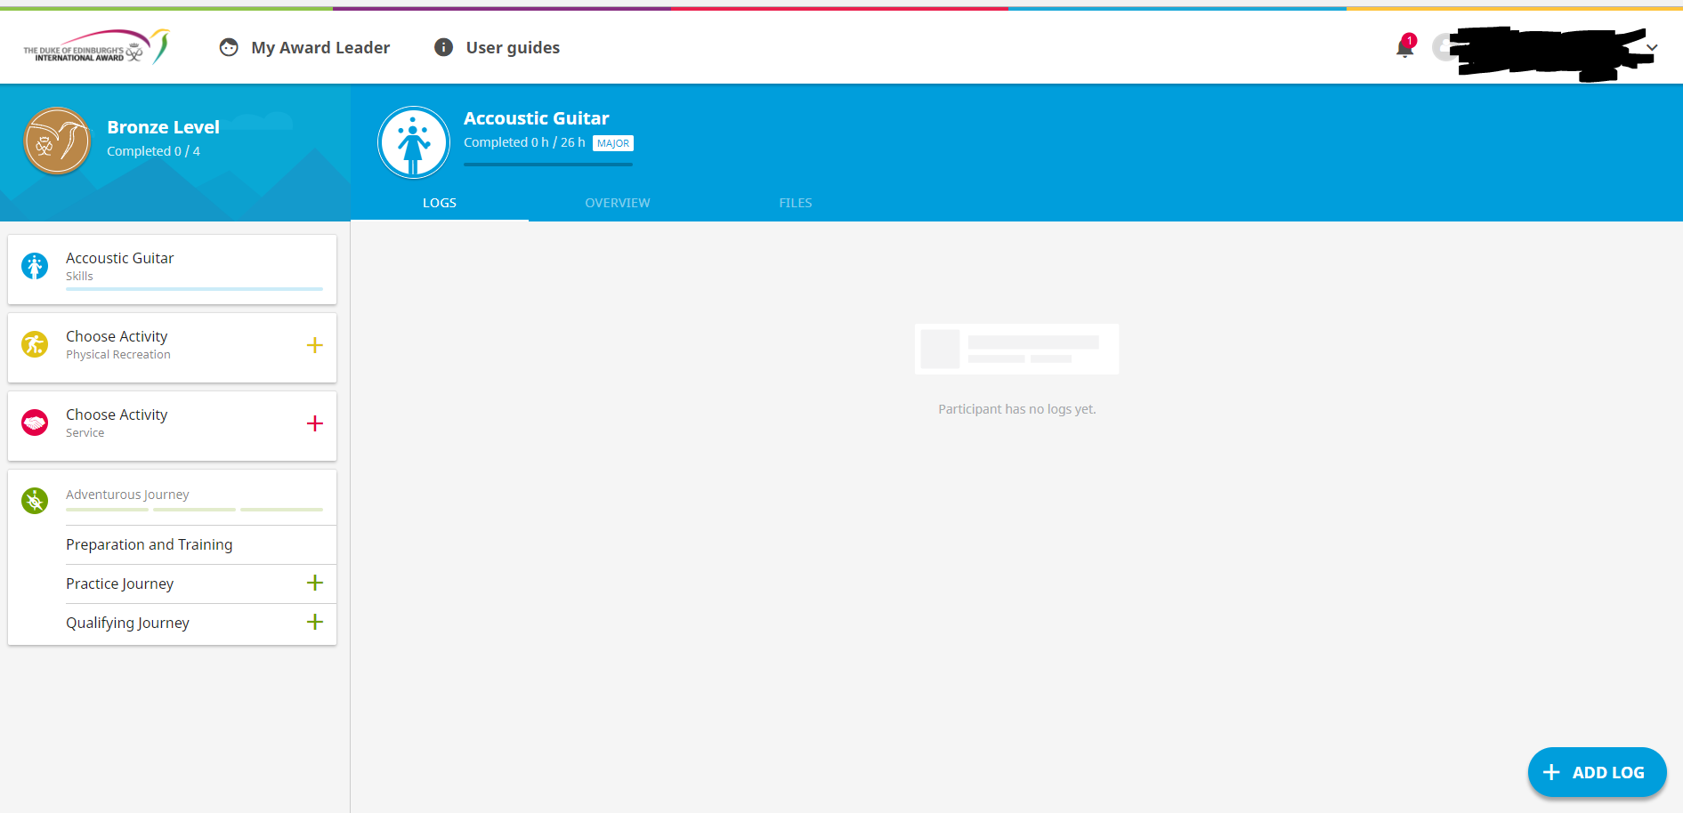
LOG HOURS!
Log your 1 hour per week here.
Please Note: The ORB will recognise a maximum of 1 hour across 7 days, 2 hours across 14 days, and 4 hours across 28 days. The ORB will not count forward, only back.

Slide 7
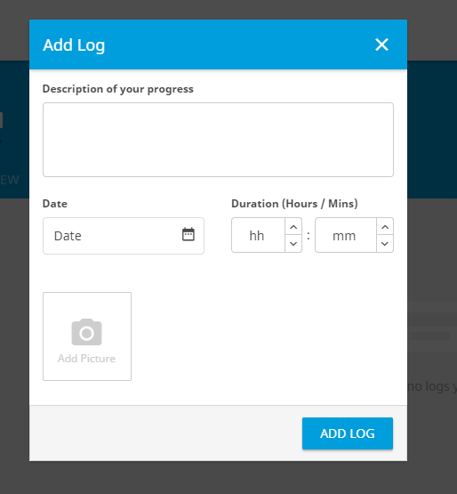
LOG HOURS
Fill in description of your activity here!
Forgot to log? Don’t worry you can add missed sessions back until your Start date ☺

Slide 8
Download the app for easy logging!

