Slide 2
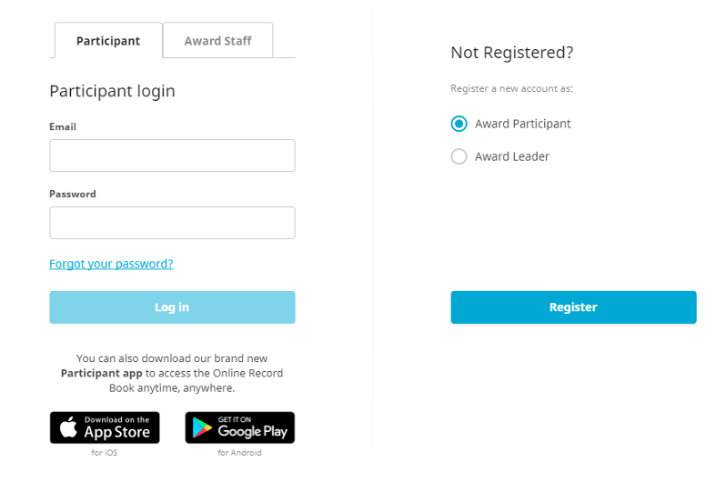
STEP 1: REGISTER
www.onlinerecordbook.org
1.
2.

Slide 3
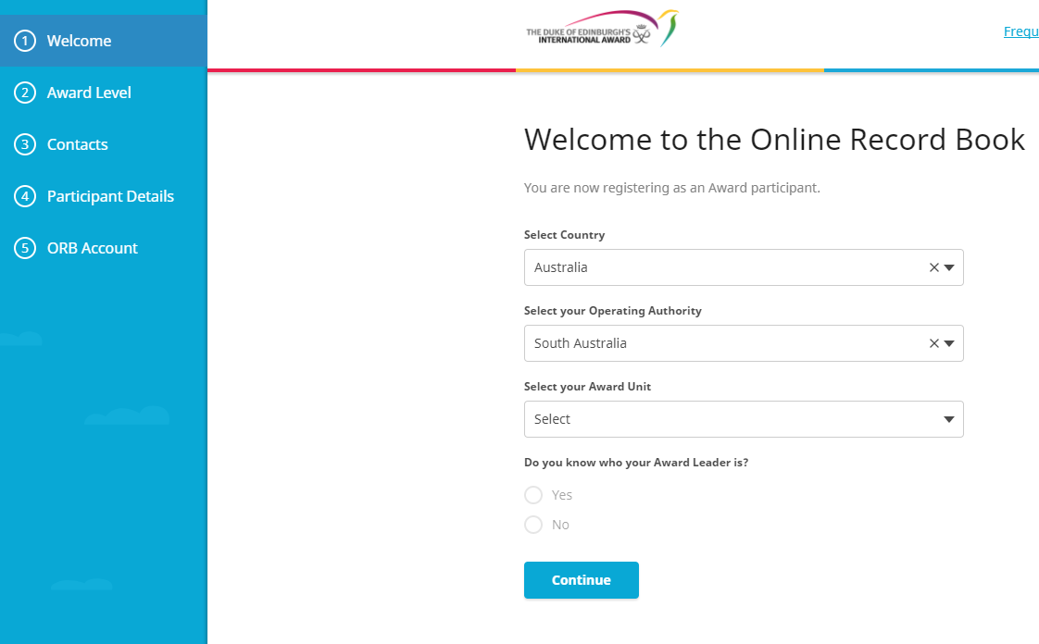
STEP 2: WELCOME
Australia
South Australia
School/ Organisation
Yes
Email address of Award Leader

Slide 4
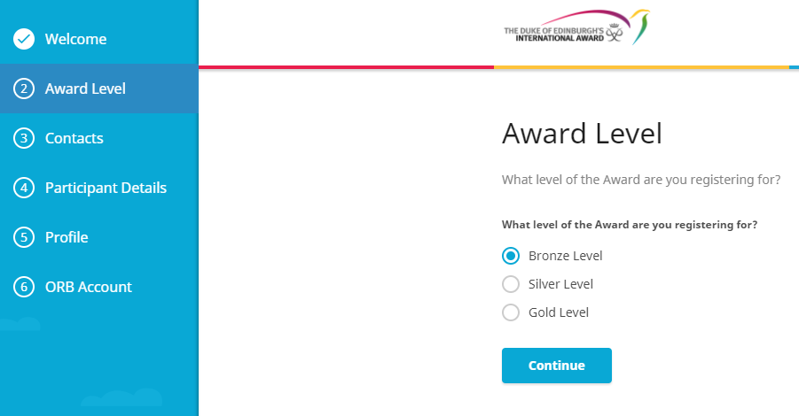
STEP 3: AWARD LEVEL

Slide 5
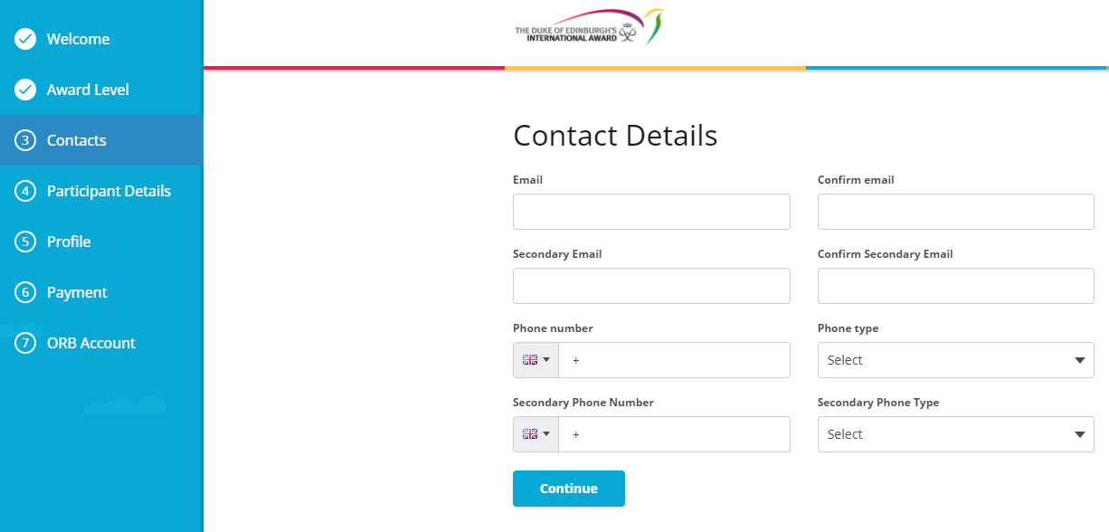
STEP 4: CONTACTS
Email will become your username
Change to AUS flag

Slide 6
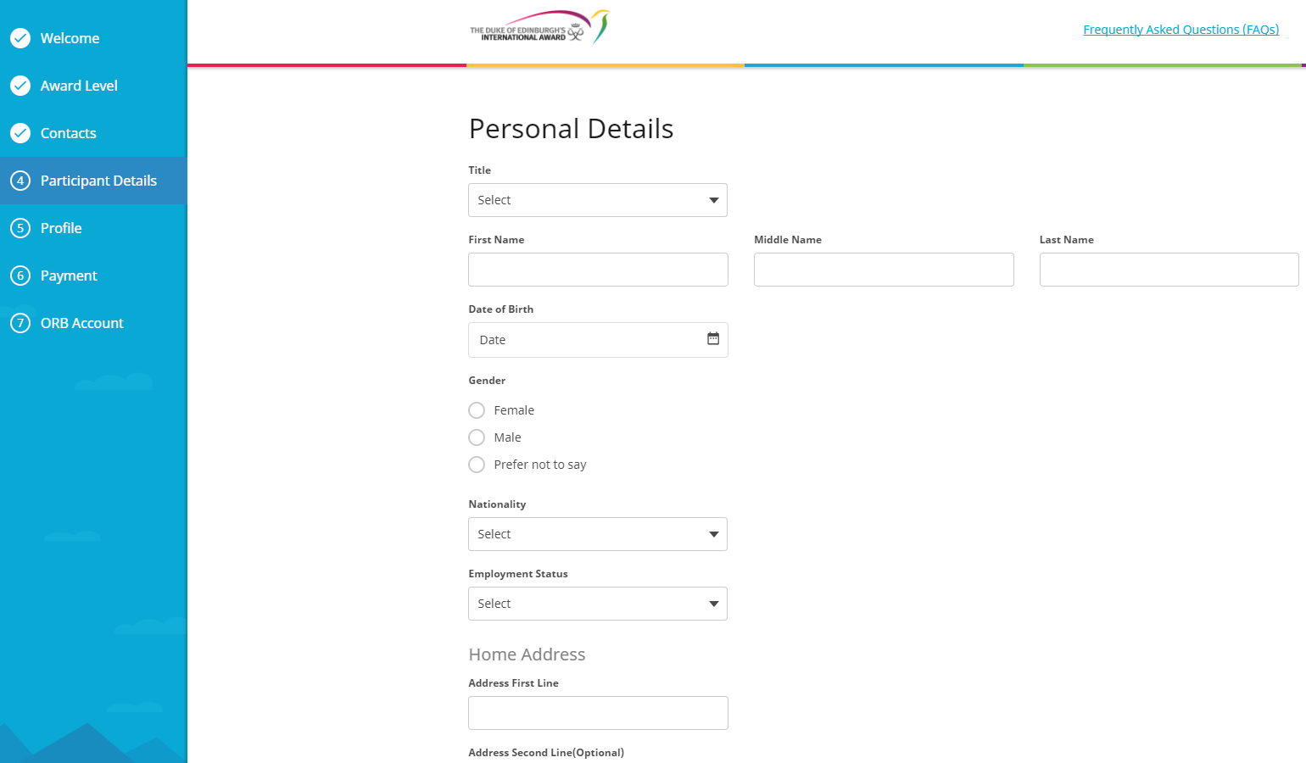
STEP 5: PERSONAL DETAILS

Slide 7
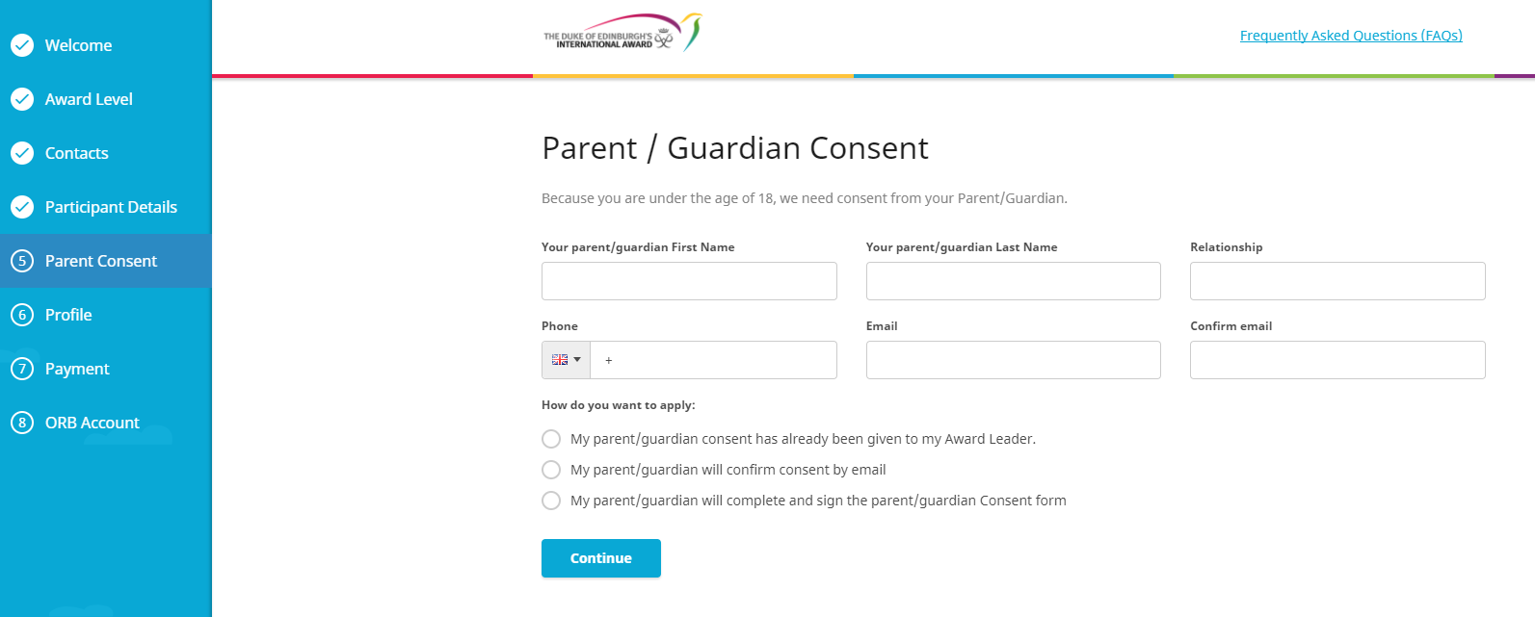
STEP 6: PARENT CONSENT

Slide 8
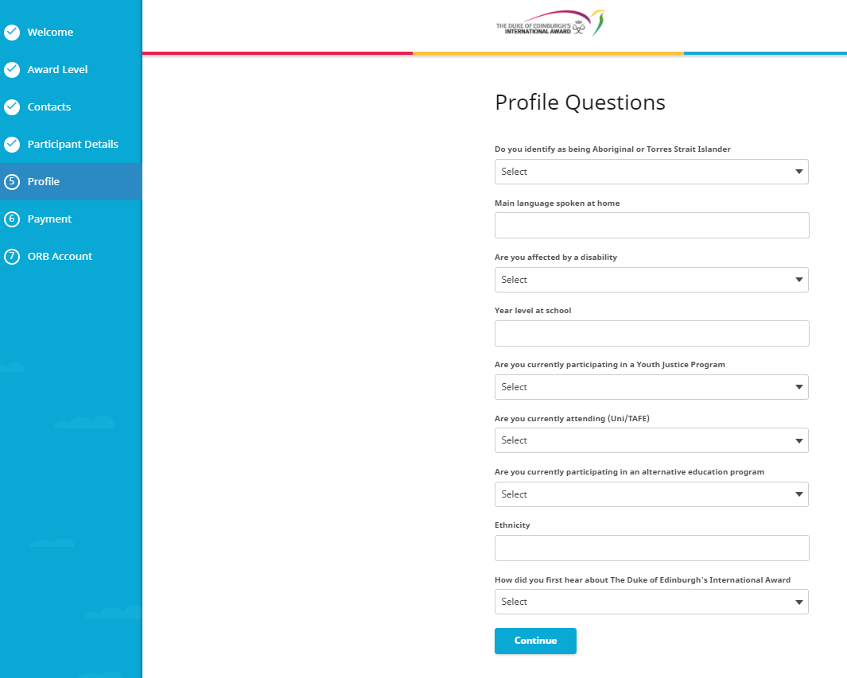
STEP 7: PROFILE QUESTIONS

Slide 9
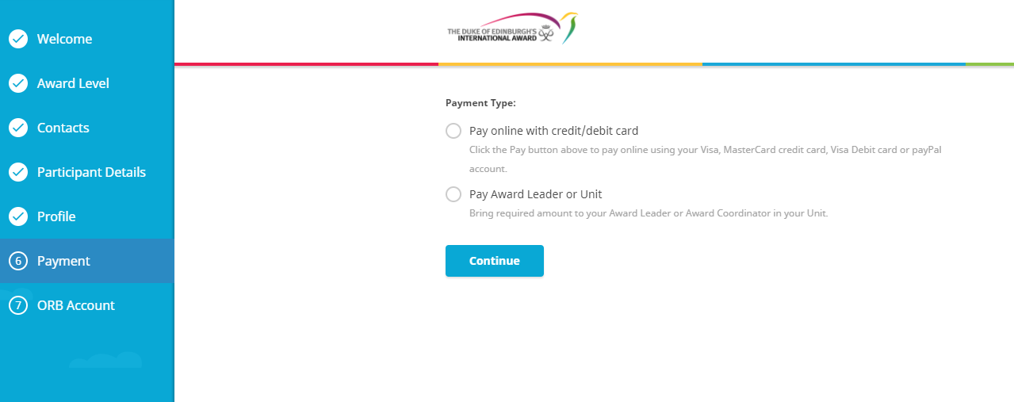
STEP 8: PAYMENT

Slide 10
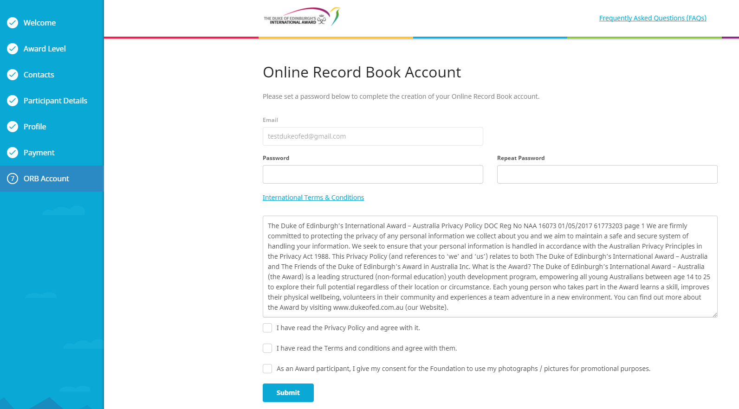
STEP 9: ACCOUNT
Set password for your account

Slide 11
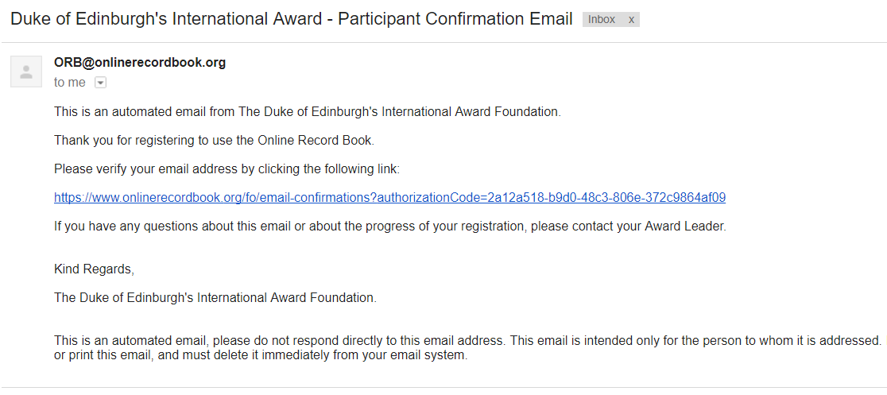
STEP 10: VERIFY EMAIL
Go to emails and click on email from Duke of Ed

Slide 12
STEP 11: WAIT FOR APPROVAL
You’re all set!
Now your Award Leader just needs to approve you online to access your Online Record Book!

Slide 13
DOWNLOAD OUR APP!
The App can be downloaded for:
• Android –Play Store
• iPhone - App Store
The Apps for the Online Record Book are supported on the latest versions only

Slide 14
NEXT STEPS
Choose your activities
Nominate an Assessor for each activity (subject matter expert)
Remember to log activities regularly
Check in with your Award Leader if you have any questions!

