Slide 1
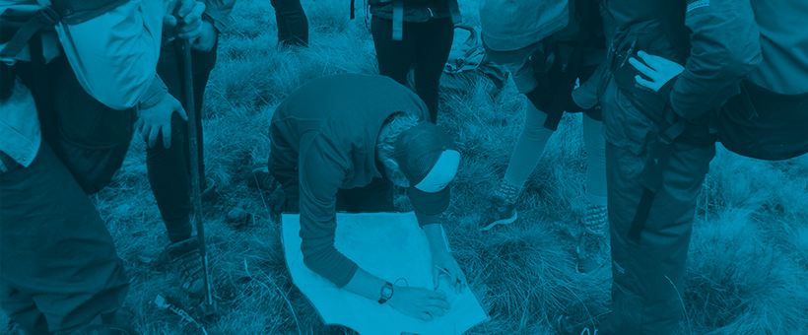
Participant Information Session

Slide 2
What is The Duke of Ed?
An internationally recognised Award that accredits non-formal education and learning outside of the classroom. Supporting individuals to achieve their own personal goals across a variety of activities in the Duke of Ed Framework.
There are three levels available: Bronze, Silver, and Gold

Slide 3
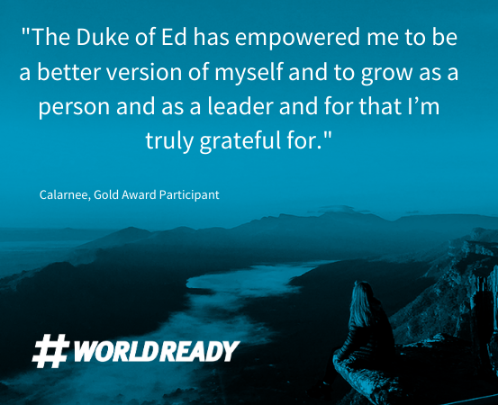
Why do The Duke of Ed?
Receive recognition for activities and interests outside of the classroom
Achieve SACE points upon completion
Work towards your own personal goals
Gain employability skills
- stand out on your resume
- talk from real life experience
- look for Duke of Ed Employers!

Slide 4
Duke of Ed Employers
A diverse range of national and South Australian employers have signed up to become ‘Duke of Ed Employers’
During their recruitment process, they may ask the question
‘Have you completed the Duke of Ed’?!

Slide 5
Duke of Ed Framework- Bronze
Physical Recreation
Choose 1 ‘Major’ section for 6 months.
2 sections for 3 months
Skills
Voluntary Service
Adventurous Journey
2 days + 1 night

Slide 6
Physical Recreation
Improve your physical fitness and wellbeing, and get active
1 hour a week, 2 hours a fortnight or 4 hours in 28 days

Slide 7
Skills
Unleash your talents and broaden personal interests and skills
1 hour a week, 2 hours a fortnight or 4 hours in 28 days

Slide 8
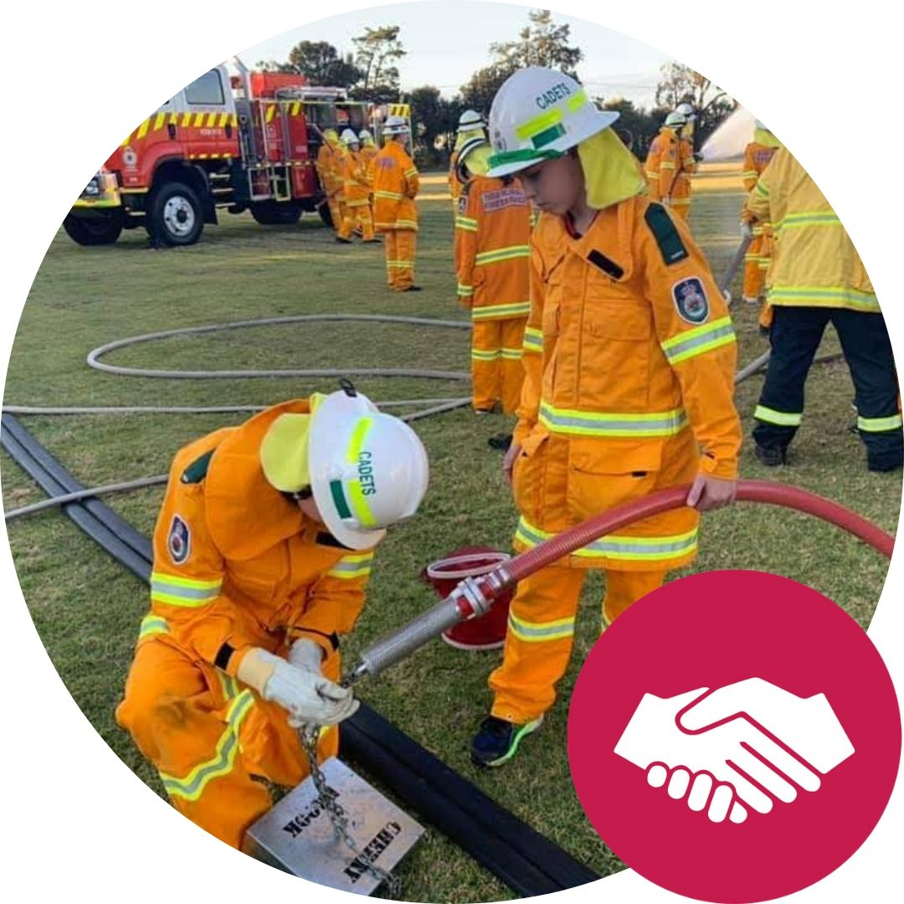
Voluntary Service
Connect with your community and give service to others
1 hour a week, 2 hours a fortnight or 4 hours in 28 days

Slide 9
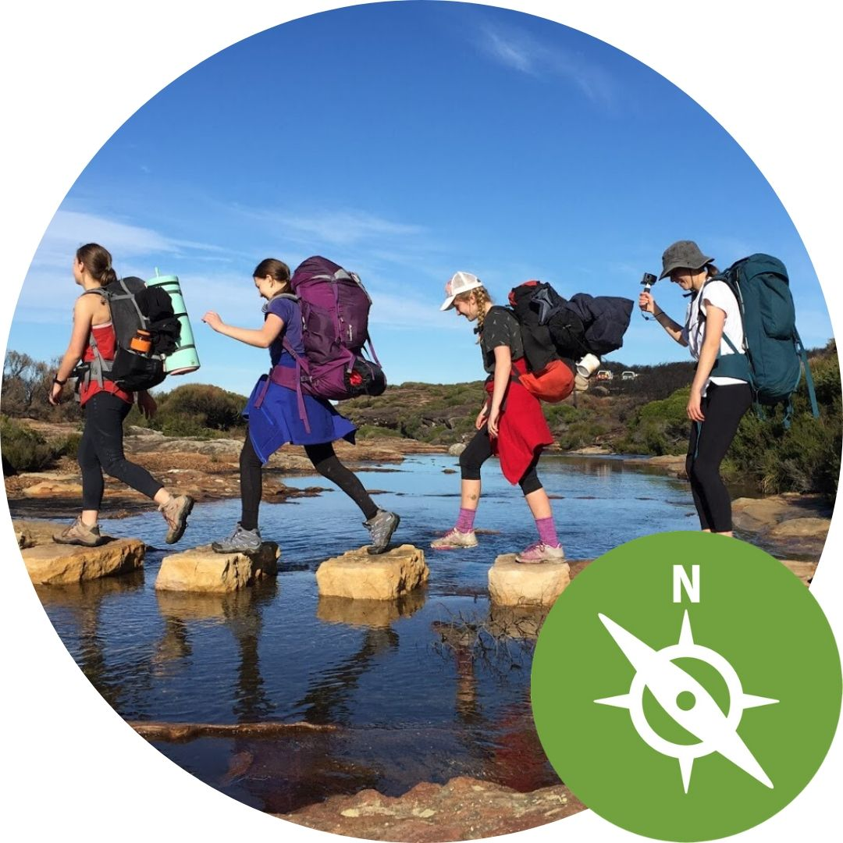
Adventurous Journey
Get out and go on an expedition or exploration in an unfamiliar and environment, in a group.
2 days* + 1 night
*6 hours daily effort

