Slide 1
The Duke of Edinburgh’s
International Award

Slide 2
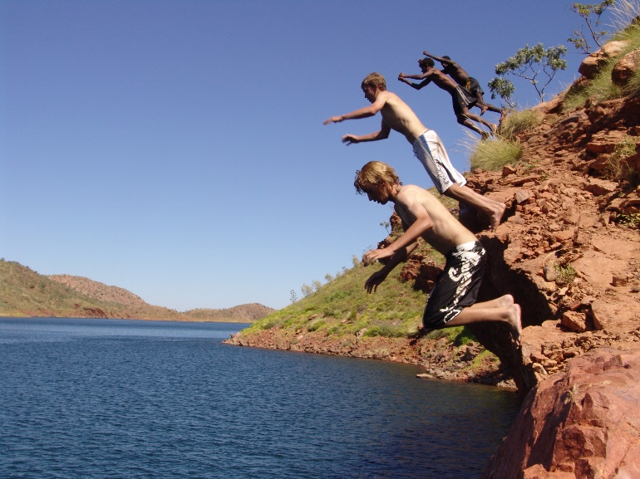
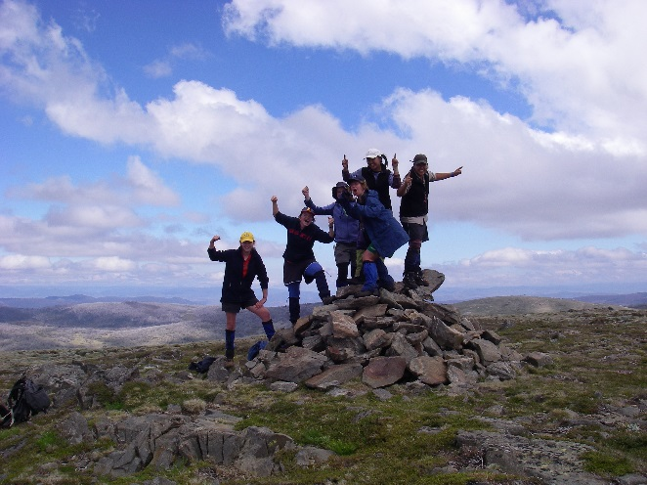
WHAT IS THE DUKE OF ED AWARD?
The Duke of Ed Award is the world’s leading youth development program, empowering all youth to explore their full potential.
The Award equips young people for life and work, challenging them to find their purpose, passion and place in the world while enhancing their educational and employment opportunities.

Slide 4
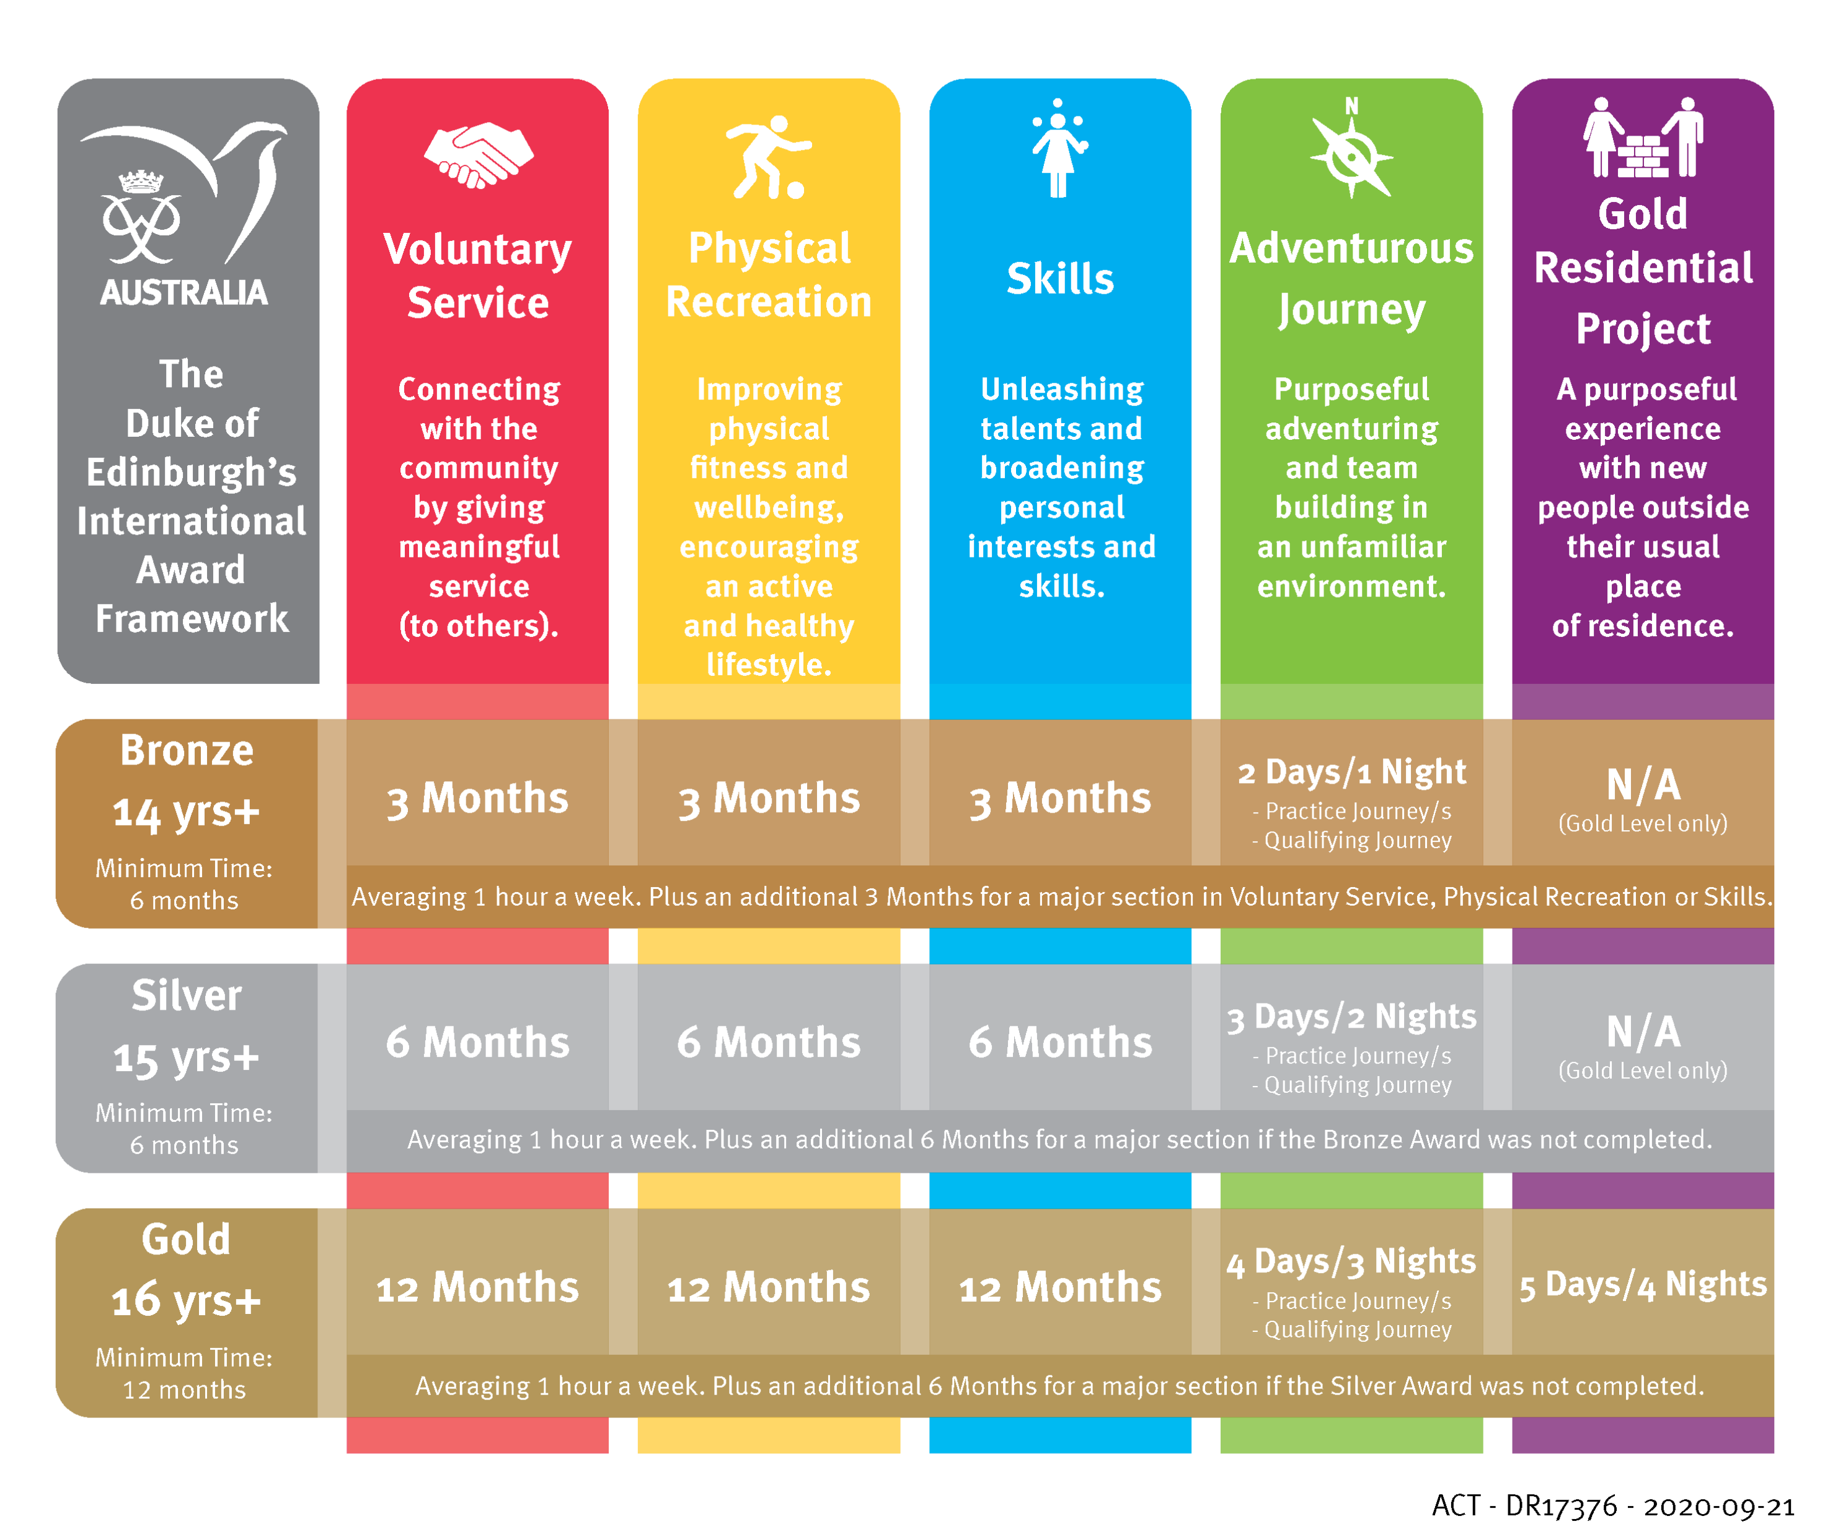
STRUCTURE - AWARD LEVELS

Slide 5
STRUCTURE - SECTIONS
Physical Recreation
Skill
Voluntary Service
Adventurous Journey
Gold Residential Project (Gold Only)

Slide 6
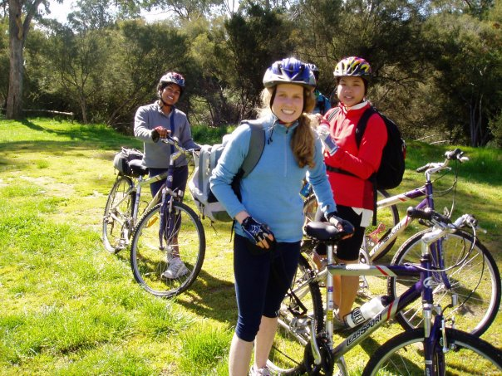
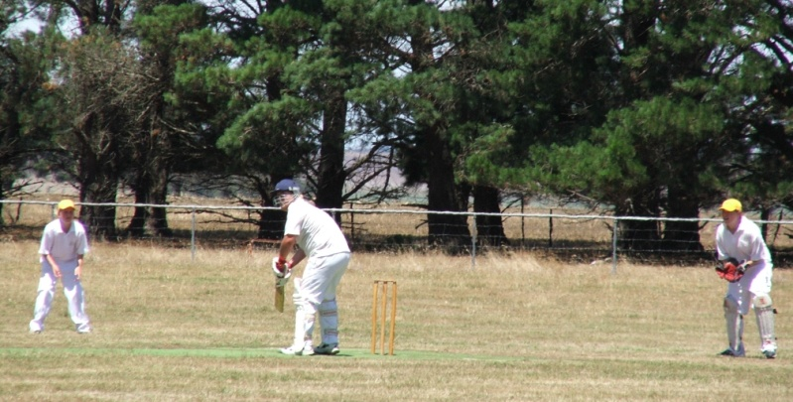
PHYSICAL RECREATION
AIM: To improve physical fitness and wellbeing, and get active
Benefits:
Developing a healthy lifestyle
Improving fitness
Increasing self‐esteem
Interacting socially
Enhancing self‐discipline, perseverance and self‐motivation
Experiencing a sense of achievement
Encouraging teamwork

Slide 7
PHYSICAL RECREATION
EXAMPLES:
Participate in a team sport
Join a dance class
Take up skipping
Try Zumba, Yoga or Pilates
Swimming
Surfing
Horse riding
Indoor rock climbing
Running
Learn a martial art
Regularly go for a walk
Skiing/snowboarding
Motorsports

Slide 8
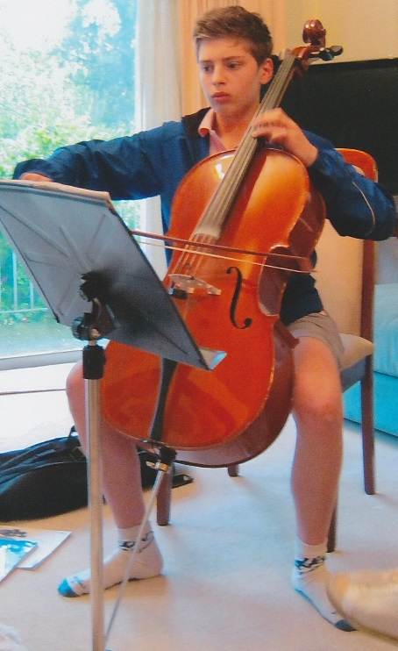
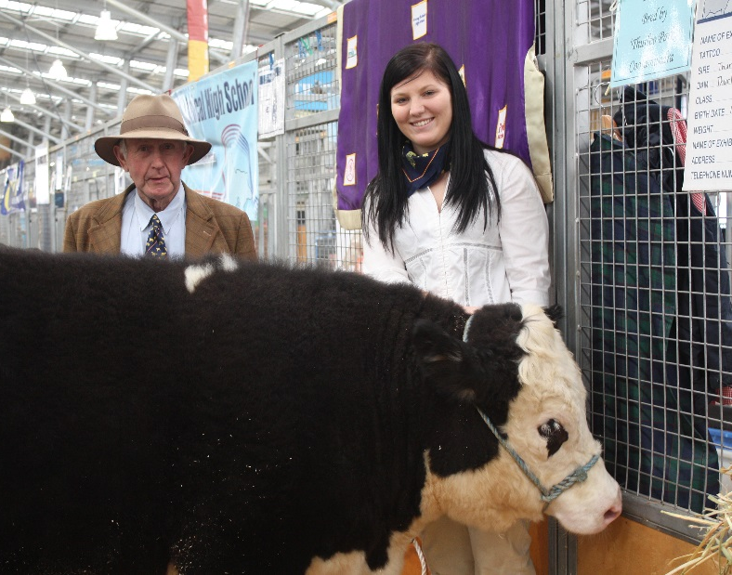
SKILLS
AIM: To broaden the development of personal interests and practical skills
Benefits:
Discovering new abilities
Increasing self‐confidence.
Developing time management and planning skills.
Enhancing self‐motivation.
Improving employability by learning vocational skills.

Slide 9
SKILLS
EXAMPLES:
Learn a musical instrument
Learn a language
Cooking
Photography
Design
Cake decoration
Sewing
Reading
Bird watching
Gardening
Chess
Hairdressing
Learning to drive
Drama and theatre skills
Umpiring and refereeing
Journalism
Event planning and organising

Slide 10
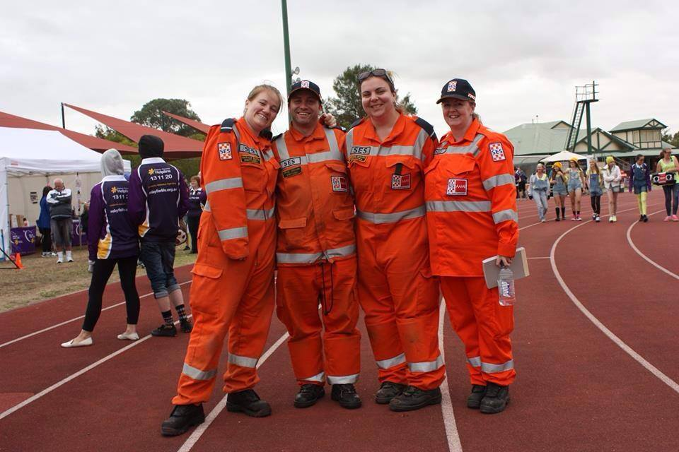
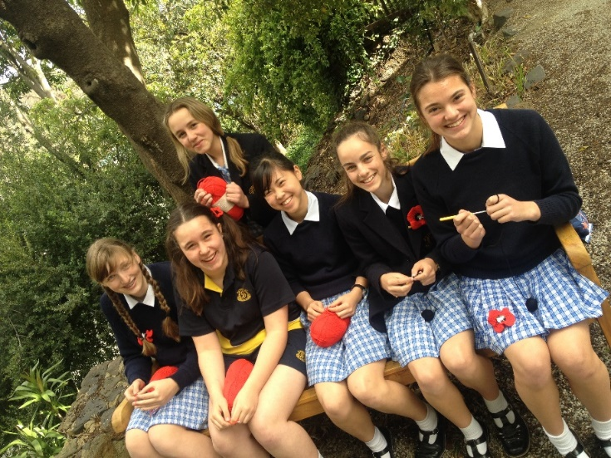
VOLUNTARY SERVICE
AIM: To connect with community and give useful voluntary service to others and their communities
Benefits:
Learning patience, tolerance, and compassion
Increasing awareness of the needs and problems of others
Enhancing leadership qualities
Making a real difference to the lives of others
Accepting the responsibility of commitment to others
Meeting new people from different backgrounds
Enjoyment and a sense of satisfaction in helping others

Slide 11
VOLUNTARY SERVICE
EXAMPLES:
Participate in a conservation project
Care for a public/school garden
Help an emergency service team (SES, RFS, CFS/CFA, St John Ambulance, Royal Lifesaving)
Care for animals under threat
Fundraise for a charity
Help at a charity clothing store
Act in a leadership role
Teach a person to read or write.
Assist in the teaching of primary school children.
Visit people in need, such as elderly or disabled people
Voluntary work in hospitals, libraries and care centers
Coach your local junior sporting team

Slide 12
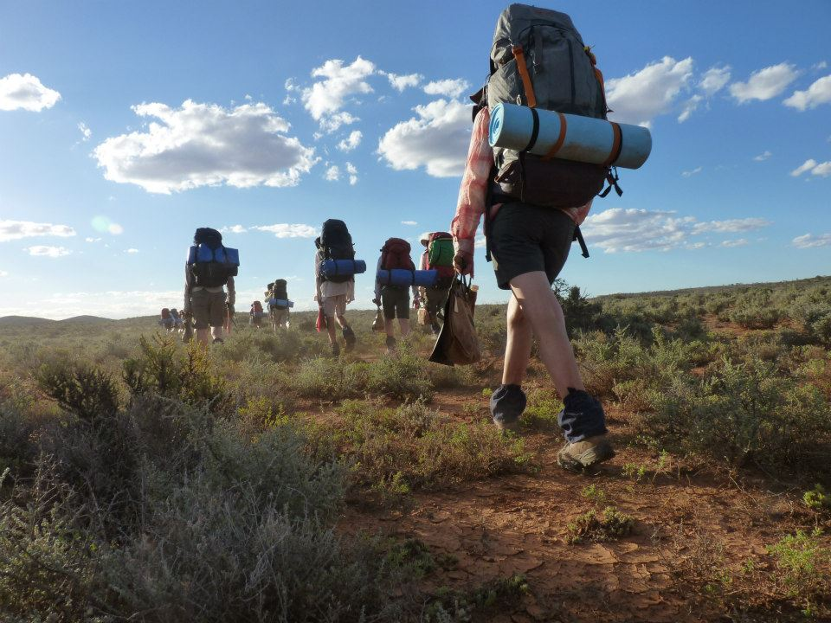
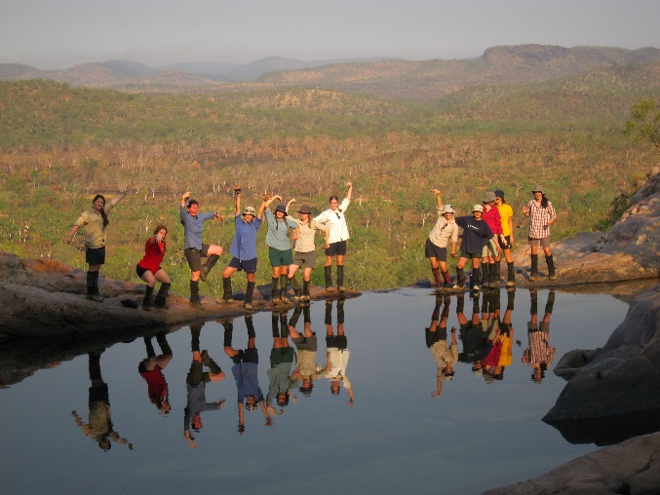
ADVENTUROUS JOURNEY
AIM: To stimulate a spirit of adventure and discovery whilst undertaking a journey in a group
Benefits:
Working as part of a team
Enhancing leadership skills
Improving planning and organisational ability
Developing self‐reliance and independence
Developing health and fitness
Experiencing and appreciating the outdoor environment
Gaining the appropriate knowledge and skills to journey safely in that environment

Slide 13
ADVENTUROUS JOURNEY
EXAMPLES:
EXPEDITION | EXPLORATION
Hiking Canoeing Cycling Horse riding Rafting Sailing Cross country skiing Motorised vehicles (eg off-road) | Scientific/Geographic explorations Historical/Cultural trips Flora/Fauna studies Mapping shipwrecks Exploration of old cemeteries in a region Experience and understand other languages/cultures

Slide 14
SELECT YOUR ACTIVITY
FIND A SUITABLE ASSESSOR
SET A SMART GOAL
WORK TOWARDS ACHIEVING YOUR GOAL

Slide 15
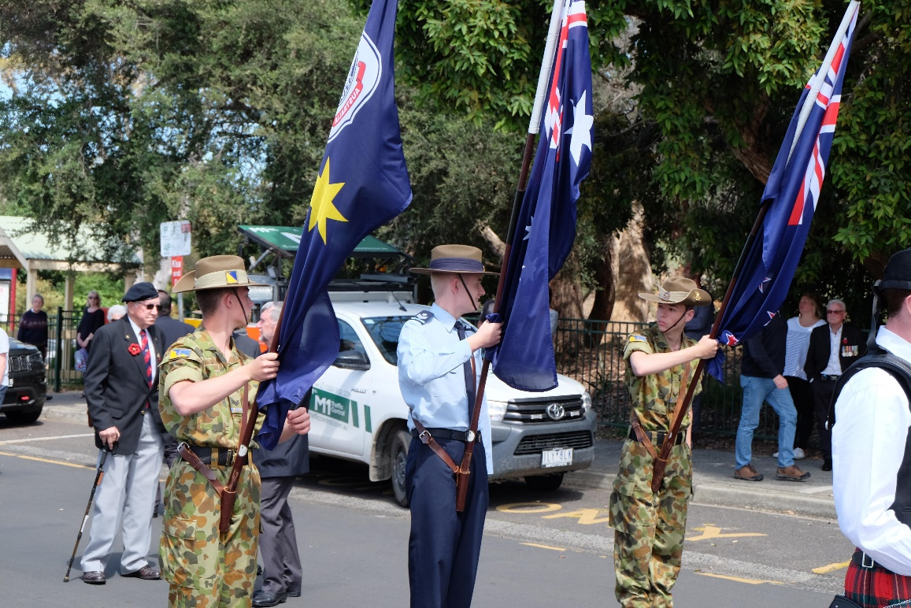
CHOOSING AN ASSESSOR
The Assessor:
Must know more about the activity than the Participant
Must be over the age of 18
Should not be an immediate family member
Must have a Working With Children Check

Slide 16
GOAL SETTING
SPECIFIC
MEASURABLE
ACHIEVABLE
REALISTIC
TIME BOUND
SMART GOALS ARE

Slide 17
WHY DO THE DUKE OF ED?
Step outside your comfort zone and be challenged
Have adventures and learn about new passions
Build confidence, resilience, and employability skills
Discover that you’re capable of things you didn’t dream were possible!

Slide 18
PATHWAYS - UNIVERSITY
TERTIARY EDUCATION PATHWAYS
ECU have approved The Duke of Edinburgh’s International Award as part of the portfolio of evidence that can be submitted with an application via the Experience Based Entry Scheme.
This pathway includes access to most of the undergraduate courses at ECU.
Follow the link below to find out more:
https://www.ecu.edu.au/future-students/course-entry/experience-based-entry-scheme

Slide 19
PATHWAYS - UNIVERSITY
“Employers want candidates who are engaged with the community and are well rounded in other dimensions, with strong personal attributes and good time management, leadership, presentation and communication skills. Completing The Duke of Edinburgh’s International Award is a strong independent signal that a student has these attributes and skills, which means they arrive at university with a head start on their peers.”
Professor John Dewar, Vice-Chancellor, La Trobe University

Slide 20
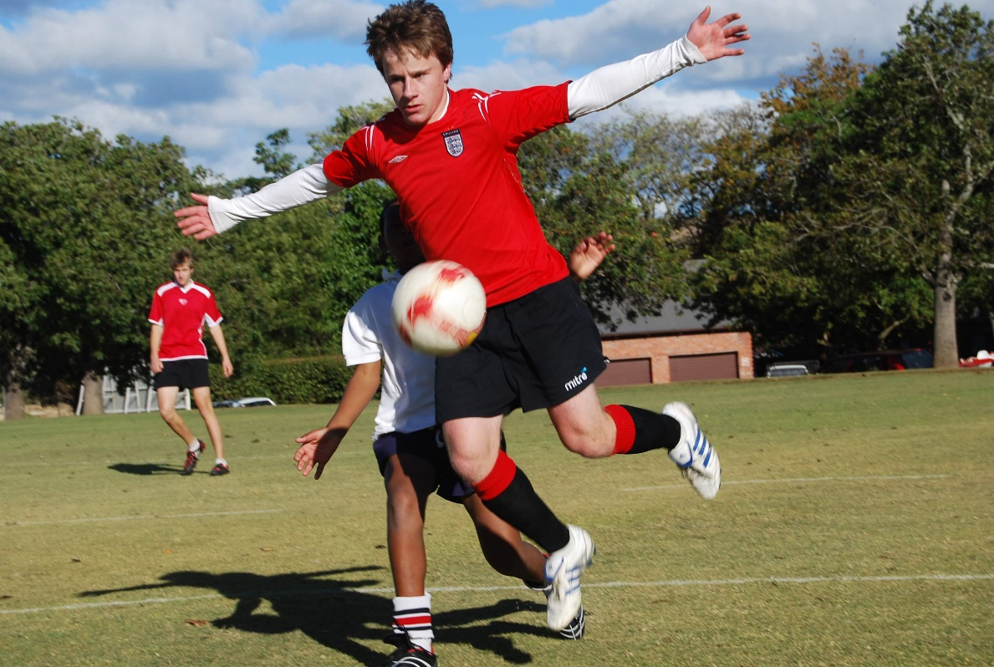
PATHWAYS - EMPLOYMENT
The Duke of Ed Employer Program gives young job seekers an edge.
Employers taking part in this initiative will ask prospective employees if they have achieved The Duke of Edinburgh’s International Award in their recruitment process.
We currently have over 90 businesses Australia-wide that are committed to harnessing the value of the Duke of Ed Award into their recruitment and staff development programs.
A recent survey of Duke of Ed Gold Awardees in Victoria revealed that 96% believed the Award increased their chance of getting a job and gained confidence to pursue their career goals.

Slide 21
PATHWAYS - EMPLOYMENT

Slide 22
YOUNG AWARD LEADERS (YALS)
‘’I developed as a real leader. My leadership skills have improved by leaps and bounds as I feel more confident talking in front of large groups of people. My organisational and communication skills have also developed due to me needing to manage and prioritize my time.”
Sophie Fontaine, previous YAL and Gold Awardee
By becoming a Young Award Leader, you will:
Gain invaluable leadership and employability skills
Learn how to influence and inspire others
Meet like-minded young and aspiring leaders
Satisfy the service or skill requirements of the Award
The training topic areas will include:
Self-Awareness and confidence
Goal setting
Effective communication and public speaking
Project management and event planning

Slide 23
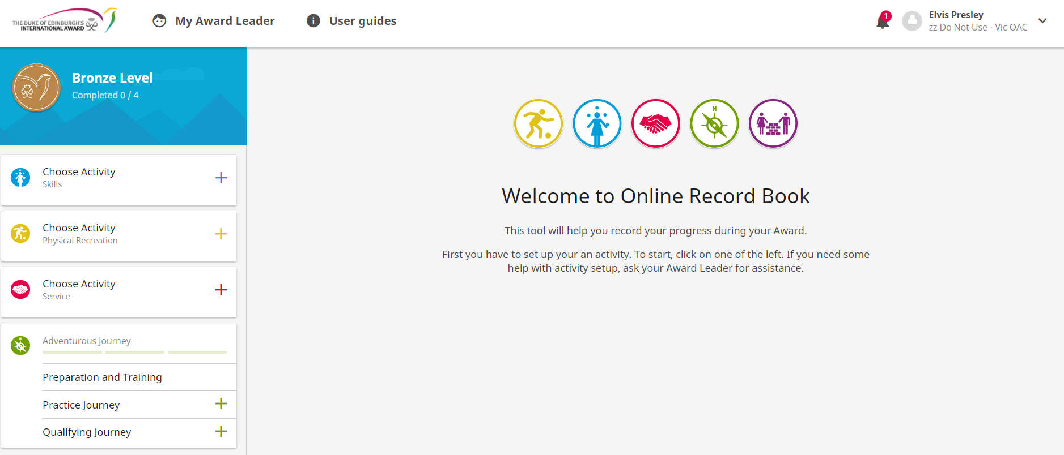
ONLINE RECORD BOOK

Slide 24
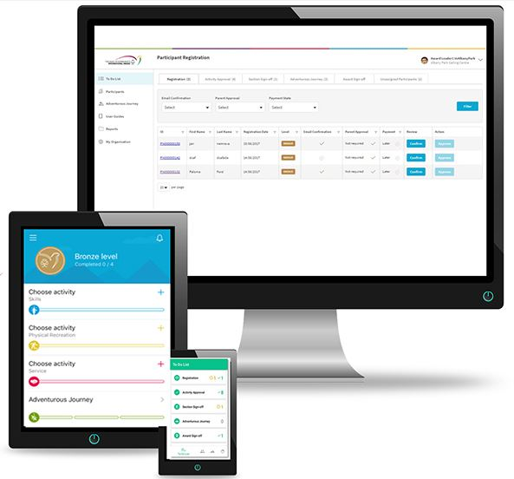
ONLINE RECORD BOOK
You can also download a free App to help you log hours!
Search for ‘’ORB Participant’’ on the Google Play or iOS App Store

Slide 25
THANK YOU

