Slide 1
The Duke of Edinburgh’s International Award- Australia (WA)
Participant presentation

Slide 3
The Award in Australia
Biggest youth self-development program in Australia for young people aged between 13 - 24
Run in over 130 countries and with 8 million Award holders!
Celebrated it’s 60th Anniversary internationally in 2019
Challenges you and rewards you for your achievements
YOU design YOUR Award around what YOU want to do!

Slide 4
Benefits
It’s enjoyable
It’s a fantastic opportunity
It will enhance your personal development
It’ll look great on your CV
An internationally recognised Award
Endorsed Program= WACE units
Recognised by Colleges and Universities in selection processes
Gain employability skills highly sought after by employers.

Slide 5
Duke of Ed Employer Program

Slide 6
Award Structure
BRONZE
13YRS +
SILVER
15YRS +
GOLD
16YRS +

Slide 7
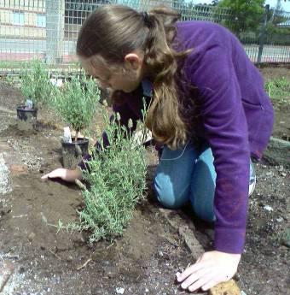
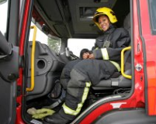
Voluntary Service
Connecting with the community and giving service to others.
Examples:
Animal care - RSPCA / WIRES
Youth Award Leader
Conservation / bush regeneration
Emergency services – SES, RFS
Fund-raising
Helping at after school care
Hospital / nursing home visiting
Library assistance
Surf Life Saving
Litter reduction / clean-up campaigns.

Slide 8
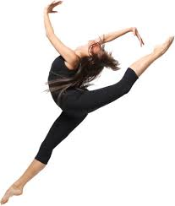
Physical Recreation
Encouraging participation in sport and other physical recreation and improvement of health and fitness.
Examples:
Athletics
Basketball
Cricket
Cycling
Dance
Golf
Gym
Hockey
Kayaking
Martial arts
Netball
Rock climbing
Rowing
Rugby
Running
Skateboarding
Soccer
Softball
Surfing
Swimming
Tennis
Walking
Yoga

Slide 9
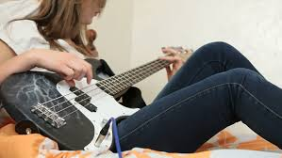
Skills
Encouraging the development of personal interests and practical skills.
Examples:
Animal training
Art
Astronomy
Chess
Coaching
Cooking
Crafts
Drama
Fashion design
Languages
media production
model construction
music
photography
pilot training
public speaking
reading
singing
web design
Writing.

Slide 10
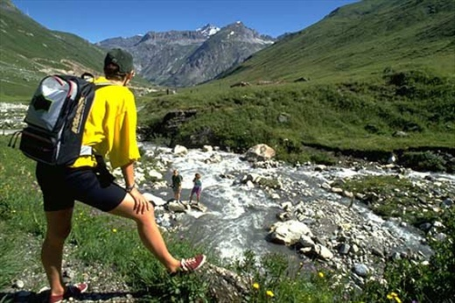
Adventurous Journey
Developing a sense of adventure and discovery whilst undertaking a journey in a group .
3 components at each Award Level:
Preparation and Training
Practice Journey
Qualifying Journey

Slide 11
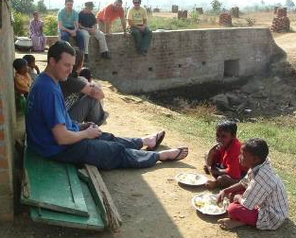
Residential Project
To broaden experience through involvement with others in a residential setting.
Requirements:
5 consecutive days
Not the Participants usual companions
Away from home
Shared purposeful activity (e.g. service or training activity)
Assessment should be by a suitable person at the residential setting.
Examples:
Leadership Camps
Edmund Rice Camp
Outward Bound Course
Crossroads Camp
Army Cadet Training – Sergeant
Junior NCO course – RAAF Base
Dolphin Research Info Centre
Conservation Camp
BHP Engineering Summer School
Surf Camp - Assistant Leader
Development Course
Scout Camp for Disabled
Cattle Station Stay
Exchange Student to Japan.

Slide 12
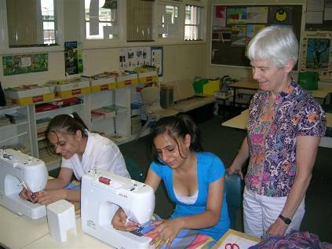
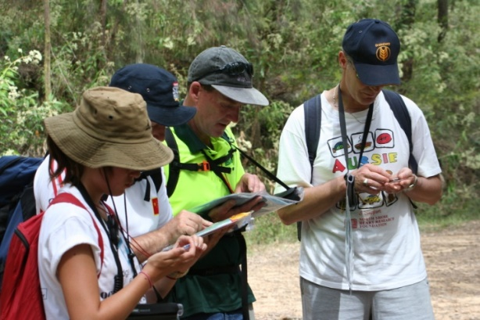
Assessors
Suitably skilled, qualified and/or experienced adults (who are approved by the Award Centre)
Assist Participants to set suitable goals
Help Participants to develop a program, stay focused and encourage/ recognise improvement (mentoring)
Record positive comments and give final signoff
Assessors should not be immediate family members.

Slide 13
Frequently Asked Questions
Can I take a break during my Award?
Can I change activities if I need to?
Do school or work activities count?
Can I do my Award in conjunction with Scouts / Surf Life Saving / Cadets etc?
Can I count any activities I was involved with prior to starting my Duke of Ed?

Slide 14
Questions

