Slide 1
Find your Purpose, Passion and Place
Participant Guide
Award Centre:
Award Leader:

Slide 2
Taking part in the Award requires commitment over time – but it is simple to get started and after all your time and effort you will have achieved something special of which you can be very proud. As an Award participant you will have the chance to:
Welcome to your Award challenge
Design your own Award program
Set your own goals and record your progress
Make a positive impact in your community through service
Learn valuable practical and social skills for career development
Take up the challenge of an adventurous journey
Get active and healthy with your physical recreation
Connect with other Award participants at home and abroad
You can continue with activities you’re already taking part in, such as sports or volunteering, and count these towards achieving your Award, or your Award could be an opportunity to try something new and develop a passion for something different.

Slide 3
What is the Duke of Ed ?
The Duke of Edinburgh’s International Award is a voluntary program that’s been enriching the lives of young people since in Australia since 1959. Participants design their own unique program that challenges them to set and meet goals while forging qualities of strength, resolve and commitment. Open to young people aged 14 to 24, the Program is run in over 130 countries and is available at Bronze, Silver and Gold levels. Each of these levels has four Sections - Skills, Voluntary Service, Physical Recreation and Adventurous Journeys. Additionally, the Gold Award has an fifth Section - the Gold Residential Project.
SECTION | WHAT IT’S ABOUT FOR PARTICIPANTS
Skills | Unleashing talents and broadening abilities and interests - anything from refereeing, to digital production, learning an instrument, to jewellery making.
Voluntary Service | Connecting with the community and providing service to others - activities such as youth work, environmental and charity work.
Physical Recreation | Improving physical fitness and wellbeing by getting active - team sports, individual pursuits or getting creative and working up a sweat.
Adventurous Journey | Inspiring a spirit of adventure and discovery in unfamiliar and challenging environments - building resilience and team spirit along the way.
THERE IS AN ADDITIONAL SECTION FOR GOLD ONLY
Gold Residential Project | Broadening horizons and challenging views of the world - in Australia or anywhere around the globe
Participants design their own program and set their goals according to the minimum requirements summarised below. Full requirements are detailed in The Duke of Edinburgh’s International Award – Australia Handbook at dukeofed.com.au
 | BRONZE | SILVER | GOLD
Skills | 3 months* | 6 months* | 12 months*
Voluntary Service | 3 months* | 6 months* | 12 months*
Physical Recreation | 3 months* | 6 months* | 12 months*
Plus for the Major Section | All Participants must complete an ADDITIONAL 3 MONTHS in either Skills,Voluntary Service or Physical Recreation | Participants who have not achieved a Bronze Award must complete an ADDITIONAL 6 MONTHS in either Skills, Voluntary Service or Physical Recreation | Participants who have not achieved a Silver Award must complete an ADDITIONAL 6 MONTHS in either Skills, Voluntary Service or Physical Recreation
Adventurous Journey | 2 days + 1 night** | 3 days + 2 nights** | 4 days + 3 nights**
Gold Residential Project | N/A | N/A | 5 days + 4 nights
Minimum age to start | 14 years # | 15 years | 16 years
Minimum age to finish (without exception) | 14 years 6 months | Bronze Awardees: 15 years 6 months Direct entrants: 16 years | Silver Awardees: 17 years Direct entrants: 17 years 6 months
Maximum age to finish (without exception) | Before 25th birthday | Before 25th birthday | Before 25th birthday
* These are minimum time requirements and are expressed in whole months, during which there should be regular commitment. Regular time commitment is based on at least one (1) hour per week, two (2) hours per two week period or four (4) hours per four week period.
**Satisfactory completion of the Adventurous Journey Section includes Preparation and Training appropriate for the journeys being undertaken and at least one practice journey of a similar nature and duration as the qualifying journey (at each Award Level).
# from 13 if in Year 9 or equivilant

Slide 4
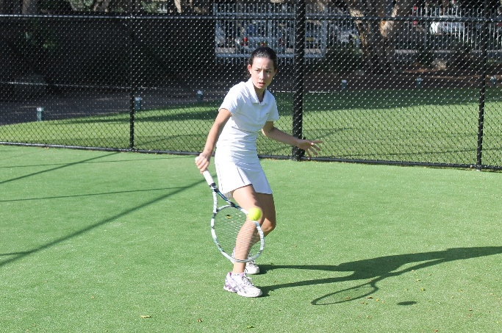
Physical Recreation
The Physical Recreation section aims to improve your physical fitness and wellbeing, encouraging you to be more active.
No matter what your physical or mental ability or inclination is, as long as you have determination, the Physical Recreation section offers the opportunity to develop healthy fitness habits that will hopefully carry on long after your Award has been achieved.
You can choose from an exciting range of activities including:
Physical Recreation suggestions approved by the Award Centre include: [insert specific examples] Netball Volleyball Football Cricket
12
13

Slide 5
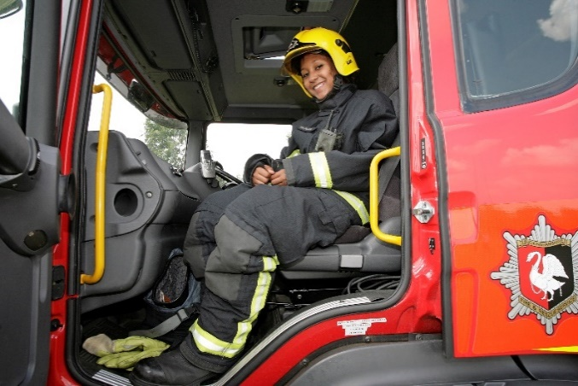
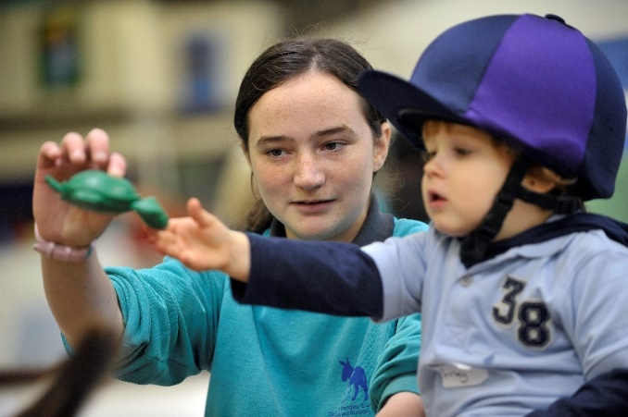
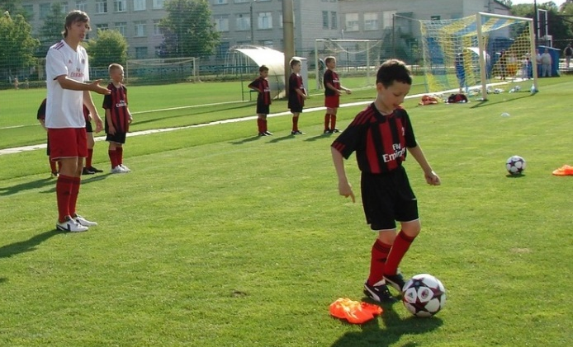
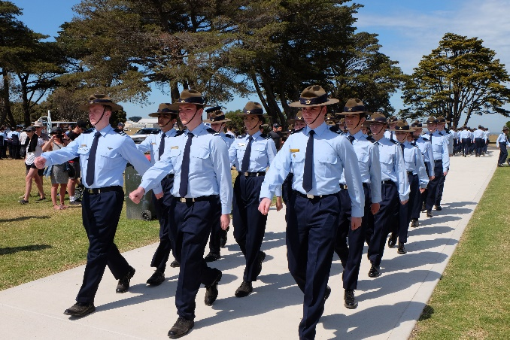
Voluntary Service
The Voluntary Service section aims to connect you with your community and give service to others and their communities.
Voluntary Service offers you the opportunity to engage with society and gain an understanding of the importance of your role within both your immediate and global community. The Voluntary Service section will give you a chance to connect with individuals and groups that you may have not previously engaged with, to make a real difference.
You can choose from an exciting range of activities including:
Voluntary Service suggestions approved by the Award Centre include: School mentoring program Fundraising Voluntary work in hospitals and care centres Sports coaching or leadership [insert specific examples]
10
11

Slide 6
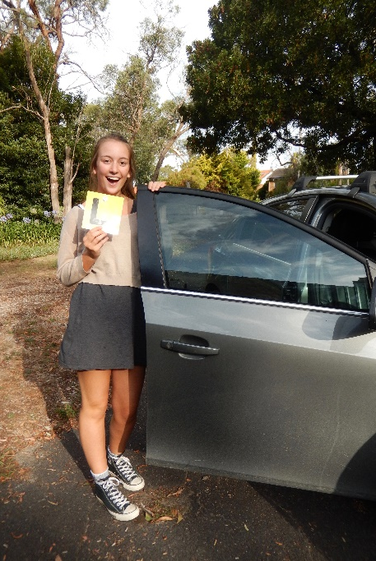
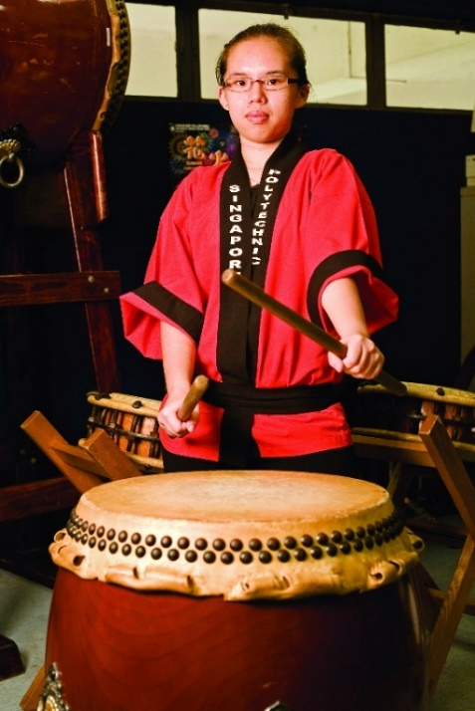
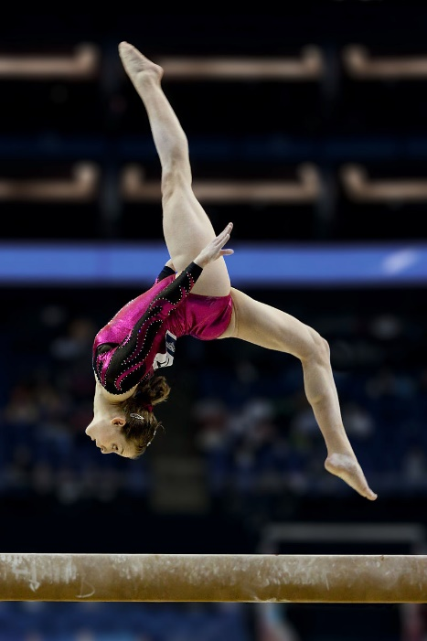
Skills
The Skill section aims to unleash your talents and broaden your personal interests and skills.
You could choose to improve on an existing skill or try something new. It’s all about having a go, learning something and getting better at it, giving yourself a sense of achievement and well- being. Colleges, universities and employers like to see that you have life skills too!
You can choose from an exciting range of activities including:
Skill suggestions approved by the Award Centre include: [insert specific examples] Learning a musical instrument Driving lessons Gaming Performance Art Visual Art
14
15

Slide 7
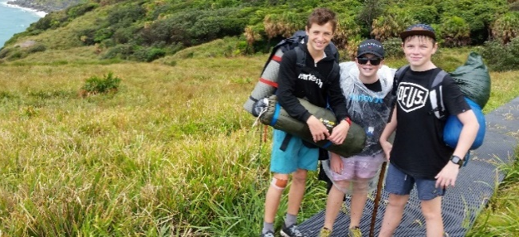
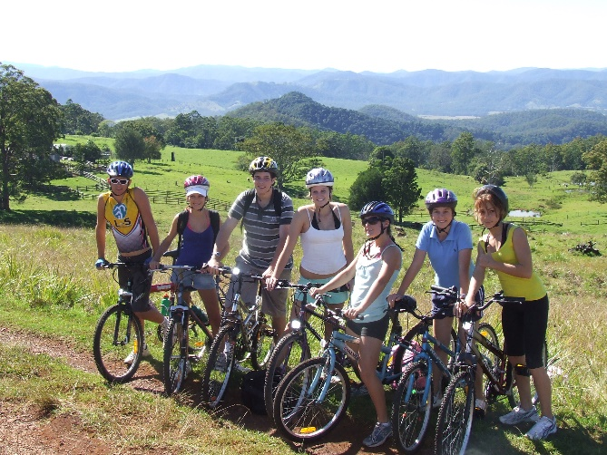
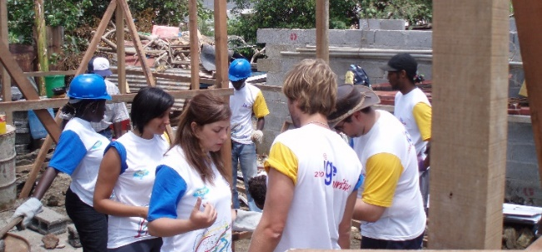
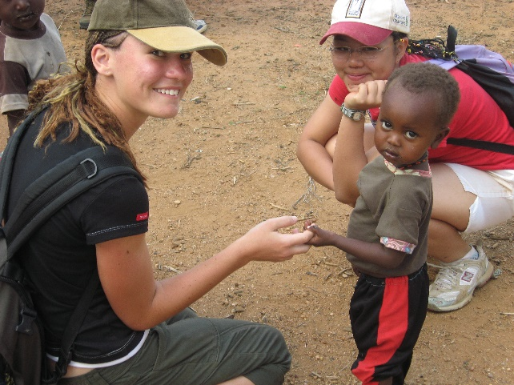
Adventurous Journey
The Adventurous Journey section aims to stimulate your spirit of adventure and discovery whilst undertaking a team journey, expedition or exploration in a small group.
You’ll have the opportunity to learn more about the wider environment, as well as to develop self- confidence, team work and health. It is a tough challenge and you might be taken out of your comfort zone for a bit but you will be safe with suitable training and supervision.
Training and Journey Dates
Term 1, Week 3 Term 3, Week 6 [insert specific dates/examples]
Gold Residential Project
At the heart of the Gold Residential Project is the undertaking of a purposeful experience with people who are not your usual companions, working towards a common goal. Adding to this, you will also be outside of your usual place of residence, often in a unfamiliar environment with unfamiliar people.
It is hoped that the Gold Residential Project rewards Gold Award Participants with a sense of personal achievement, enhanced social connection an a truly life changing experience.
Gold Only
Activities suggested/approved by the Award Centre include: Sports coaching course Construction projects [insert specific examples]
regret it!
16
17

Slide 8
Useful Resources
WEBSITE www.dukeofed.com.au
AWARD HANDBOOK
Go to www.dukeofed.com.au > Resources > Participant Resources > Guidelines
Handbook – The Duke of Edinburgh’s International Award
PARTICIPANT AWARD PLAN
Go to www.dukeofed.com.au > Resources > Participant Resources > SA
SA Participant Award Plan
ONLINE RECORD BOOK
Go to www.dukeofed.com.au > Resources > Online Record Book > ORB Resources
ONLINE RECORD BOOK (ORB) Helpdesk For technical issues or login problems, please contact
Email: orb@dukeofed.com.au
Phone: 1300 4 DUKES (1300 4 38 537), Press Option 1
Available Monday to Friday between 8.00am and 6.00pm AEST
The Duke of Edinburgh’s International Award – South Australia
Postal Address: GPO Box 2441, Adelaide SA 5001 Tel: 02 8241 1530 Email: InfoSA@dukeofed.com.au
Useful links
https://dukeofed.com.au/resources/useful-links/
> Resources > Useful Links
Acknowledgements
This publication has been reproduced by the Duke of Edinburgh's International Award Australia from the The Duke of Edinburgh’s International Award Foundation. This publication has been inspired by the work of The Duke of Edinburgh’s Award in the United Kingdom and their publication DofE Participants’ Handbook. The Foundation would like to acknowledge and thank the DofE UK for their co-operation in the creation of this international publication.
19

