Slide 1
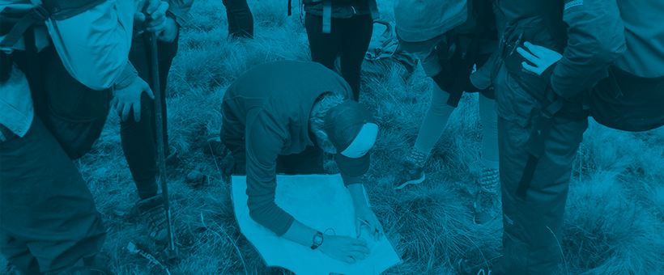
Participant Information Session

Slide 2
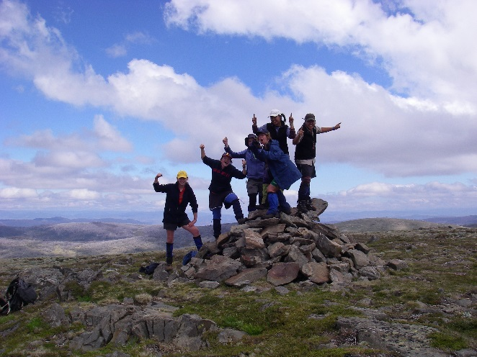
What is The Duke of Ed Award?
An internationally recognised youth program that challenges individuals to achieve their own personal goals for various activities, across a specific timeframe.

Slide 3
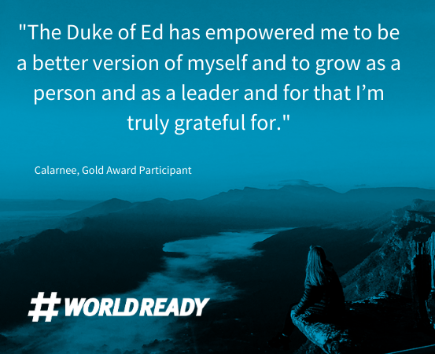
Why do The Duke of Ed Award?
Be recognised for activities outside of the classroom
SACE points
Work towards your own personal goals
Gain employability skills
- stand out on your resume
- talk from real life experience
- look for Duke of Ed Employers!

Slide 4
Duke of Ed Employers
A diverse range of national and South Australian employers have signed up to become ‘Duke of Ed Employers’
During their recruitment process, they may ask the question ‘Have you completed a Duke of Ed Award’?!

Slide 5
The Four Sections - BRONZE
Physical Recreation
Choose 1 ‘major’ section for 6 months.
2 sections for 3 months
Skills
Voluntary Service
Adventurous Journey
2 days + 1 night

Slide 6
Physical Recreation
Improve your physical fitness and wellbeing, and get active
1 hour a week, 2 hours a fortnight or 4 hours in 28 days

Slide 7
Skills
Unleash your talents and broaden personal interests and skills
1 hour a week, 2 hours a fortnight or 4 hours in 28 days

Slide 8
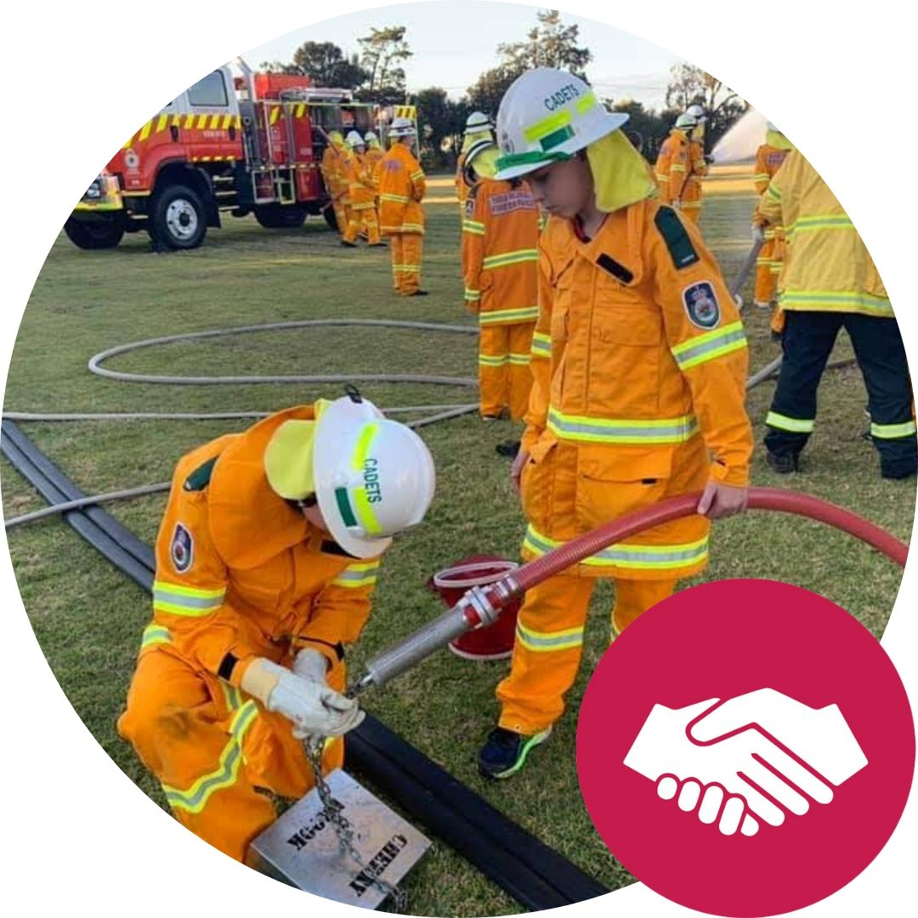
Voluntary Service
Connect with your community and give service to others
1 hour a week, 2 hours a fortnight or 4 hours in 28 days

Slide 9
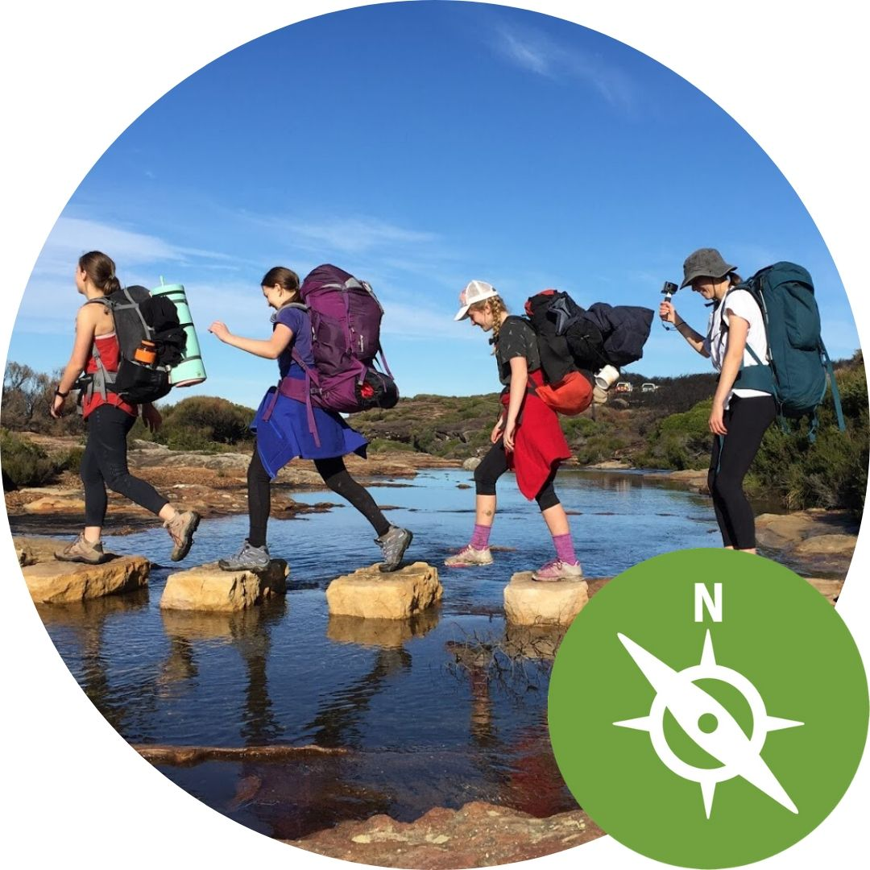
Adventurous Journey
Get out and go on an expedition or exploration in an unfamiliar and environment, in a group.
2 days* + 1 night
*6 hours daily effort

